Slide 1
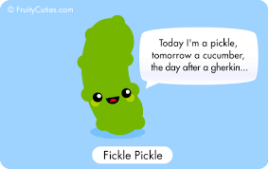
Behavior Driven Development Gherkin
March, 2017

Slide 2
Agenda
Approaches
BDD
Benefits of BDD
BDD principles
BDD tools and implementation
What is Gherkin
How to Write Gherkin
Project Example.

Slide 3
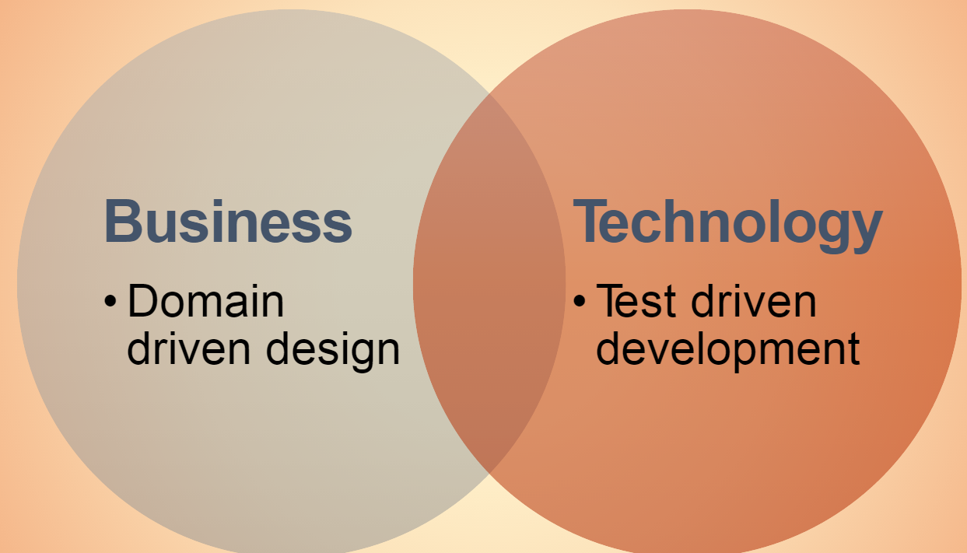
Development Approaches

Slide 4
BDD and its benefits…
A technique used to write maintainable documentation that brings together users and developers with common language, that acts as acceptance criteria defined for each story.
It ensures single source of truth by merging specification and test documentation into a single document.
Benefits of BDD:
All stakeholders involved in the discussion drives out clear and concise specifications centered around business value.
Write specifications in natural language so everyone is on the same page
Turn the specifications into acceptance tests that guarantees the software does as it is intended
Use those tests as the software evolves to guarantee that it continue to work as intended.
Specifications are documentation- each scenario describes how the system is being used.

Slide 5

Continuous Improvement
Not Fail Early, Fail Often = Its Learn Early, Learn Often
Inspect & Adapt; Feedback early and often
Retrospectives at the Team level, and Program level

Slide 6
Agile Mindset
Agile Manifesto, featuring collaboration (new slide)
Prime Directive (new slide)
Impact != Intent
Continuous Improvement (new slide)
Not Fail Early, Fail Often = Its Learn Early, Learn Often
Inspect & Adapt; Feedback early and often

Slide 7
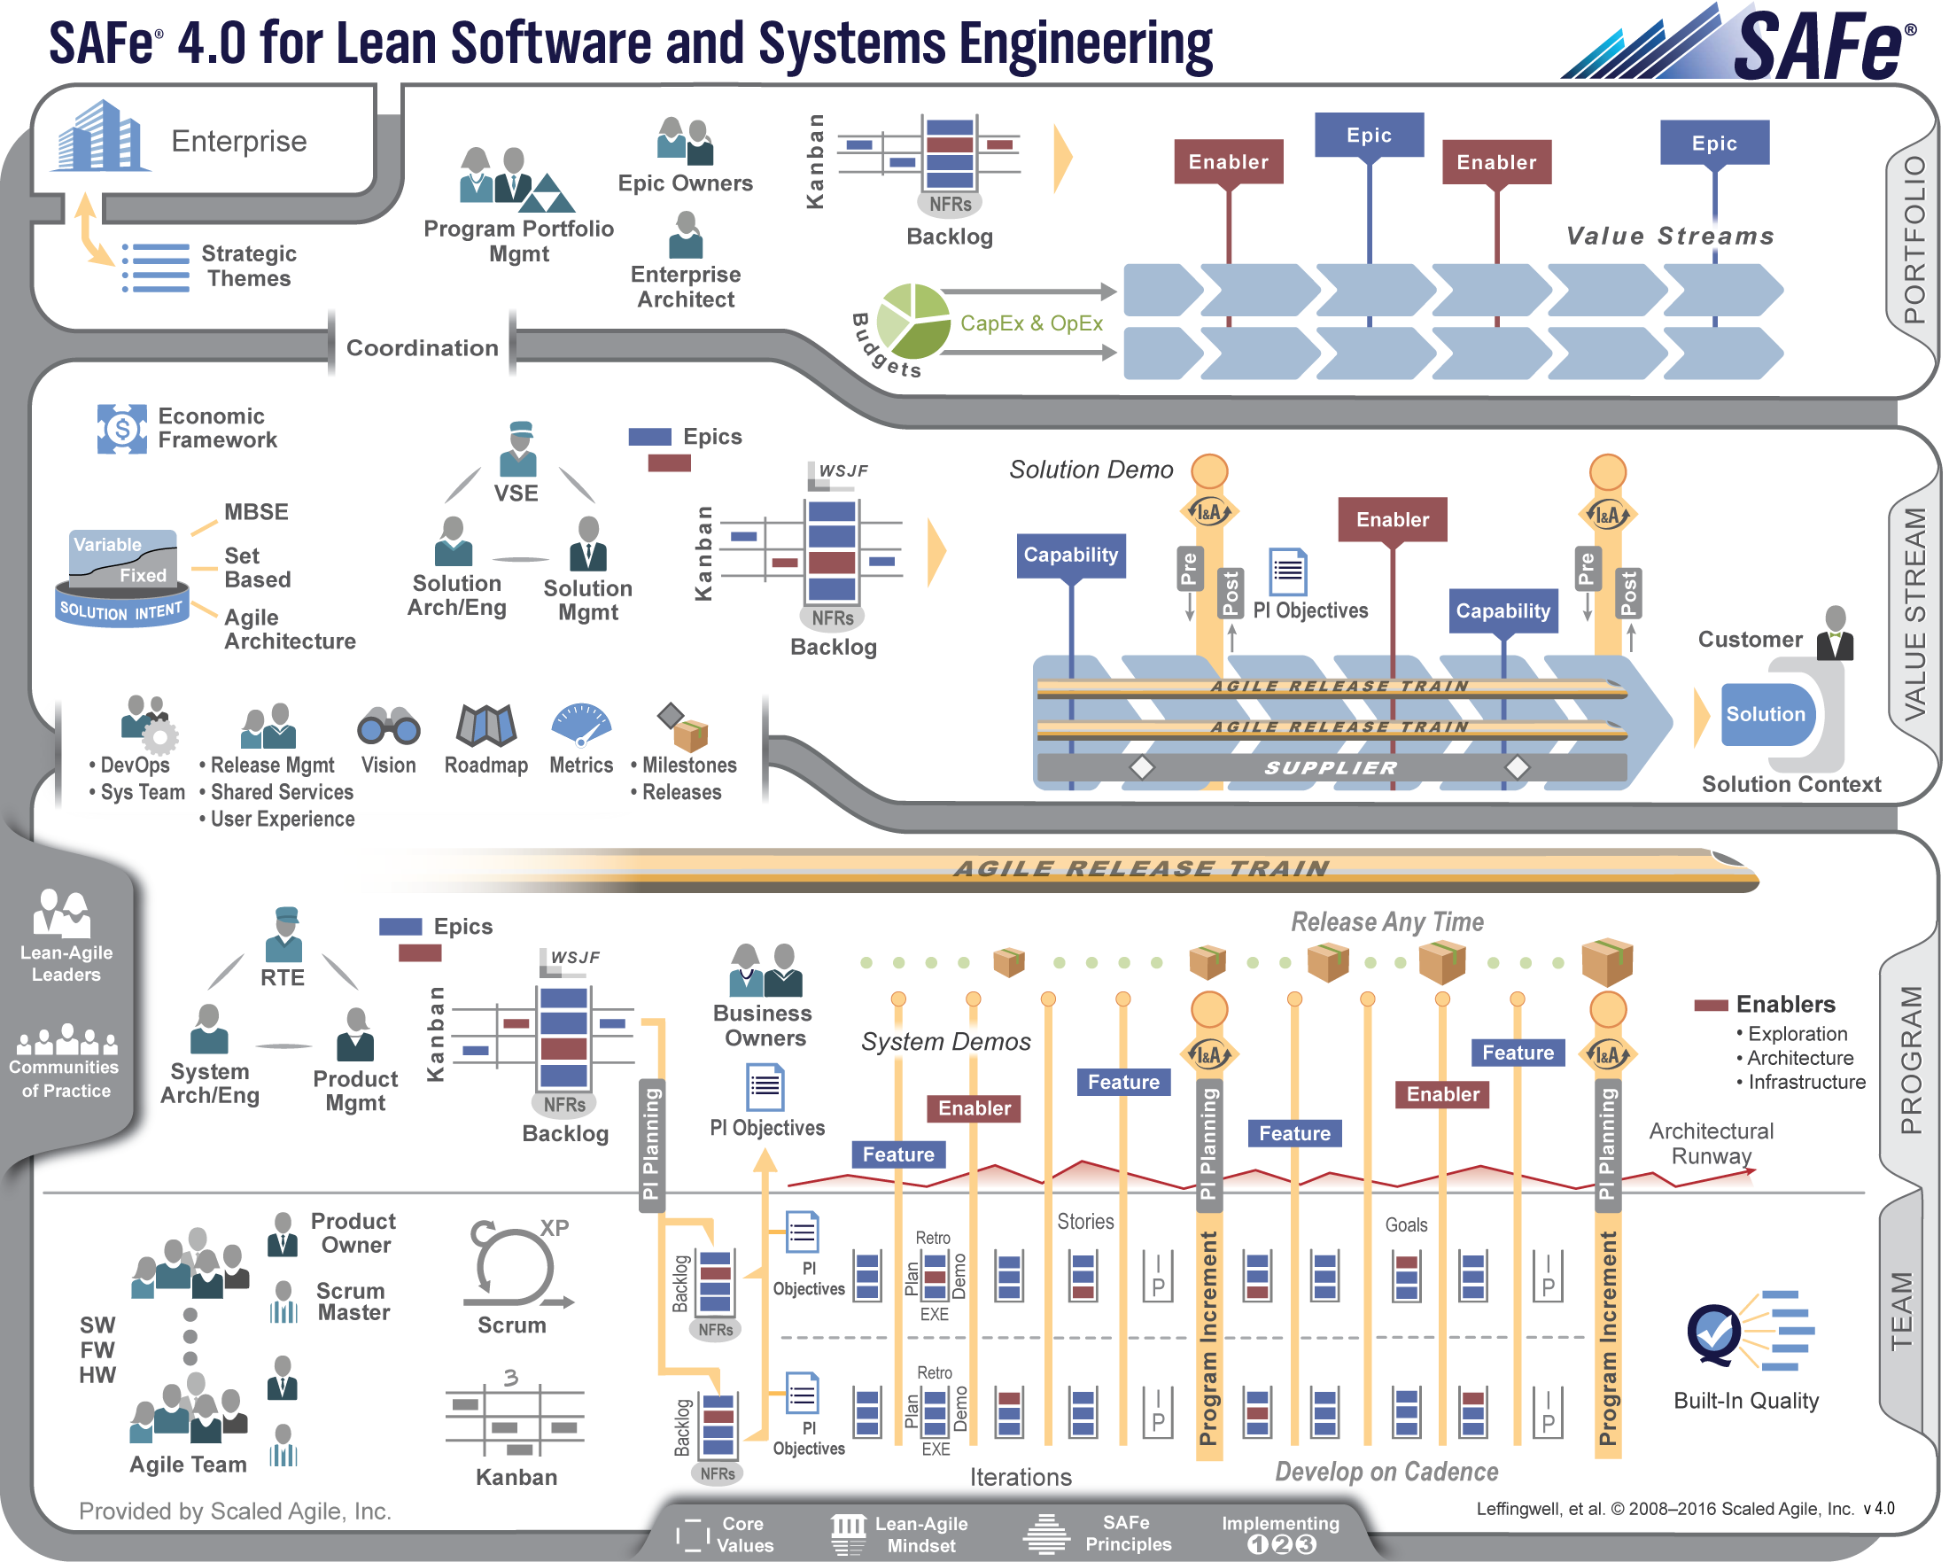
SAFe 4.0 Introduction

Slide 9
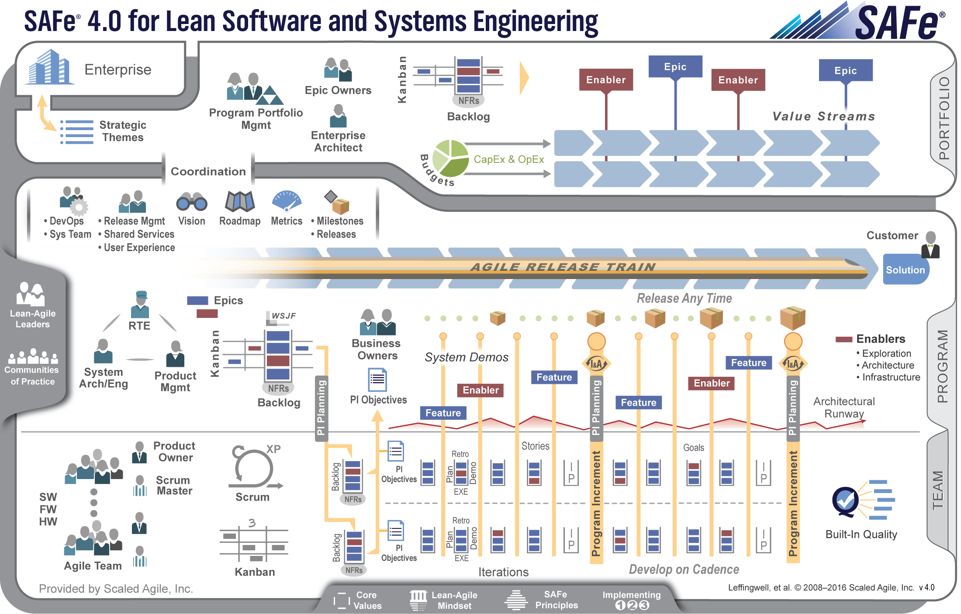

Slide 10
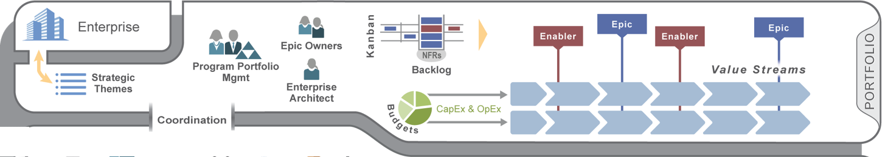
Portfolio Level
Bi-direction connection to the enterprise via strategic themes
Program portfolio management
Discovery, definition, and administration of major initiatives (epics)

Slide 11
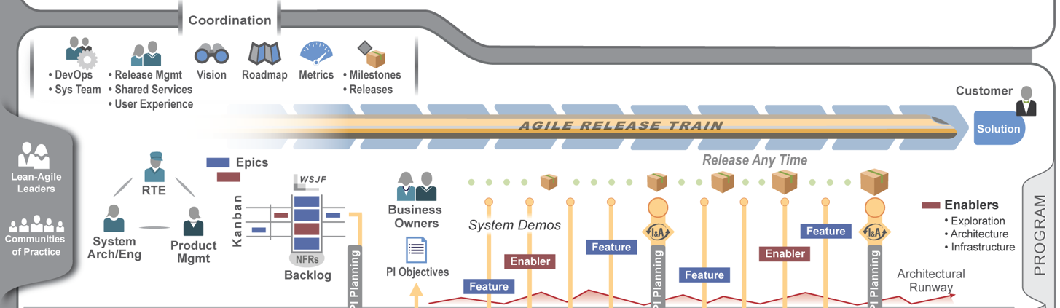
Program Level
Uses the metaphor of a Agile Release Train (ART), a team of Agile teams that deliver incremental release of value
ARTs are virtual organizations, coordinated via release train engineer
ARTs are composed of 5 to 12 teams
Each ART includes all roles and infrastructure needed to delivery fully-tested, working, system-level software (system team, devops, release mgt, shared services)
Everyone is “on the train”

Slide 12
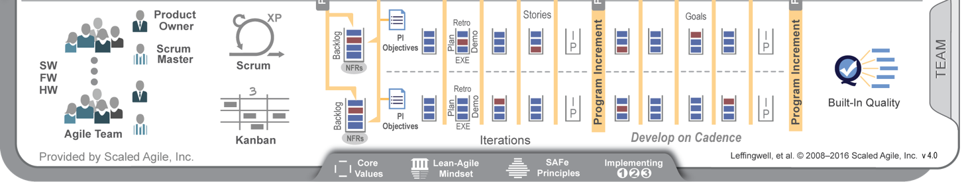
Team Level
Self-organizing Scrum/XP or Kanban teams that deliver the features/components
Includes developers, system testers, technical leads, solution architects and product owners
Intense collaboration
All teams are “on the train”
Plan together, integrate and demo together, learn together

Slide 14
Team Structure Overview

Slide 15
System Team
Release Train
Component Teams
Feature Teams
Coordination, Integration, Shared Services
Component Teams (L2 & L3)

Slide 16
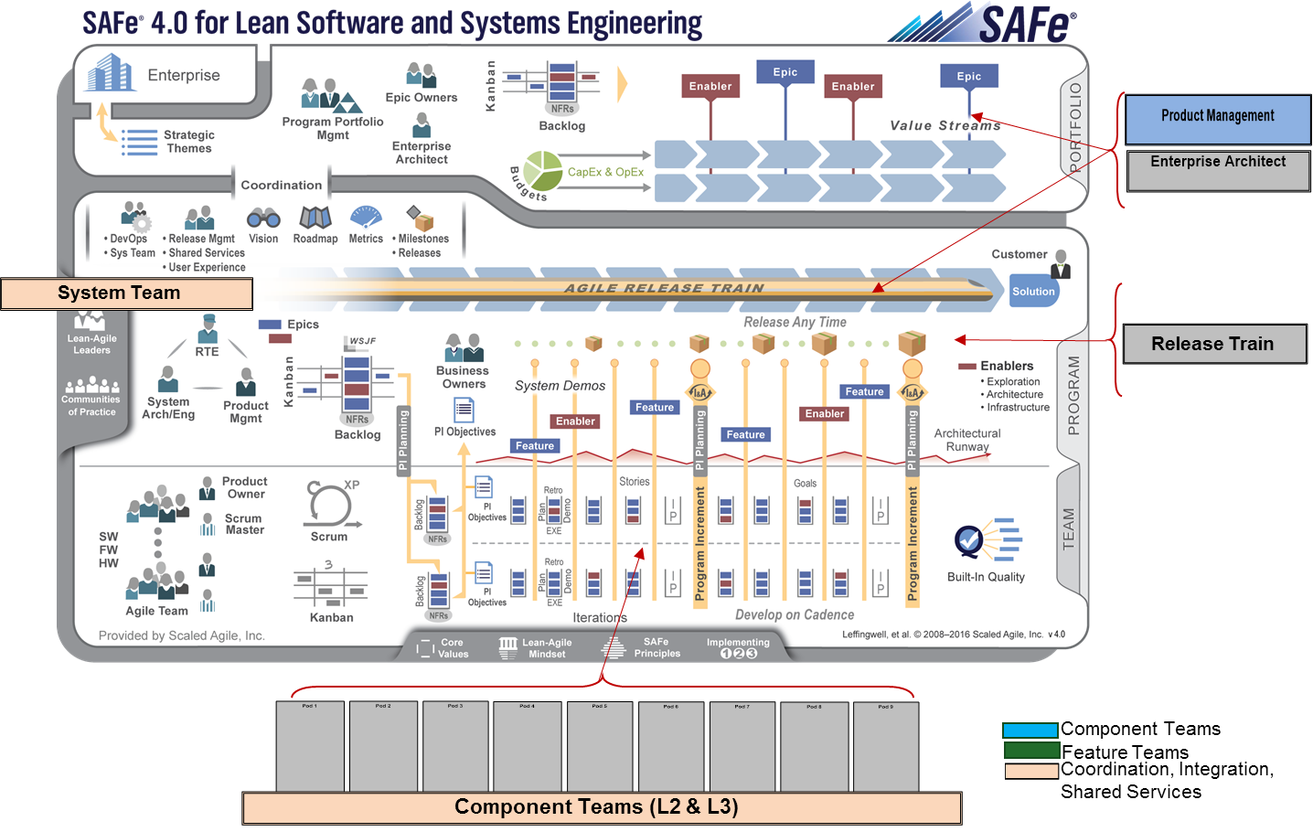
Team Structure: Component vs. Feature Teams
Feature Teams
Organized around user-centered functionality
Can Deliver Functionality without dependency on other teams
All skillsets required to deliver user stories are embedded on team
This will be our target whenever possible
Component Teams
Organized by technical system
Highly dependent on other teams
Only deliver a slice of functionality to be consumed by other teams
Used when there is a high technical specialization required

Slide 17
Team Structure: System Team
Build Development Infrastructure
Automate Deployments
Create Environment for Demos
Maintain Environment Infrastructure
System Integration
Define Inter-component Interfaces (where needed)
E2E Solution Testing & Performance Testing
Demo Participation – System & Solution Demos

Slide 18
Team Structure: Shared Services
People that cannot be dedicated full-time to a team, because it’s impractical
Examples:
Security Specialists
DBAs
Data Modelers
Enterprise Architects / Information Architects
Desktop Services
Many Others..
May form a separate team
May embed on agile teams as needed

Slide 19
How would we scale this beyond AUT?
So far, we have focused on only on the AUT Program Team
What would this picture look like if we were to incorporate other programs at Fannie Mae?
The beauty of this framework is that it’s extensible beyond just us

Slide 20
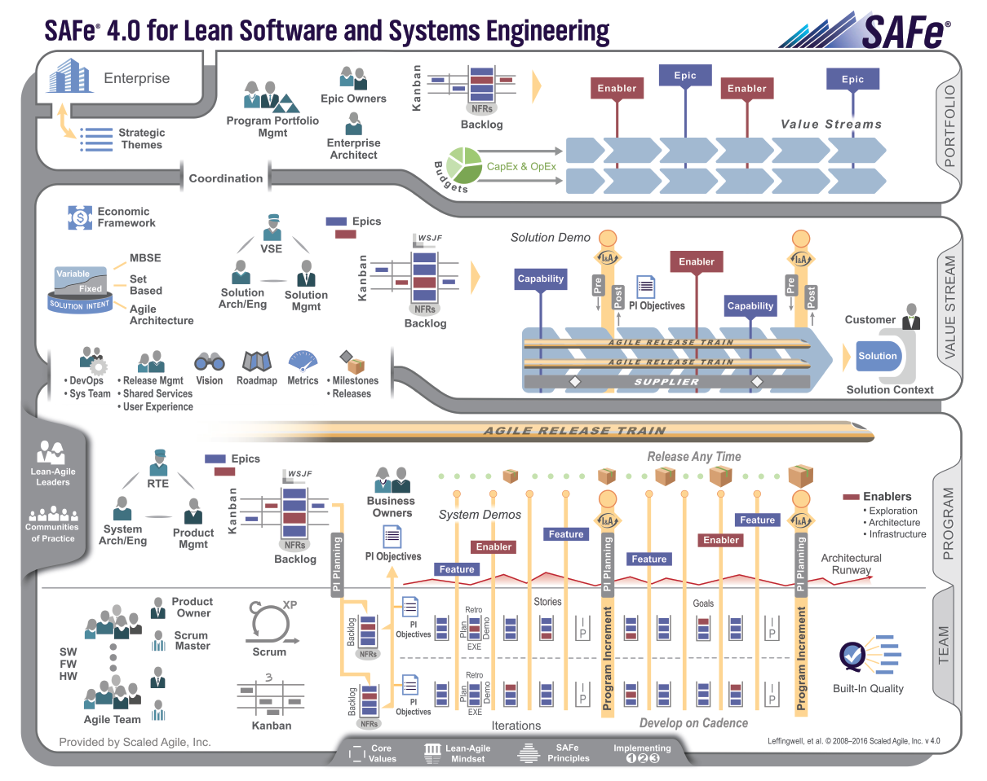
Future State
AUT ART
LDNG ART
CU ART

Slide 21
Training and On-going Support
Product Owner Training
Whole Team Training
Coaching at Team, Program, and Portfolio levels
Customized Workshops and Activities
Facilitation

Slide 22
Product Owner Training
1-day interactive workshop
In-person attendance is required
Topics include:
Agile history and mindset
Product owner role deep dive
Product vision and epics
Features and user stories
Empathy mapping
Story mapping
Story splitting
Agile planning
Scrum/kanban

Slide 23
Agile Team Training
2-day interactive workshop culminating in a fun hands-on simulation
In-person attendance is required
Topics include:
Agile history and mindset
Cross functional teams
Product vision and epics
Features and user stories
Story splitting
Agile technical practices
Agile planning
Definition of ready
Definition of done
Team working agreements
Scrum/kanban simulation

Slide 24
Rough Timeline
October
November
December
Support Business Team
Conduct Product Owner Training
Create & Define Epics
Conduct Whole Team Training (2 Teams)
Create Features & Stories
Kick-Off Iteration
Conduct Whole Team Training (2 Teams)
Create Features & Stories
Kick-Off Iteration
* All remaining teams will follow the same structure and cbe completed by the end of Q1’2017

Slide 25
Rough Timeline
Q4:2016
Q1:2017
Q2:2017
Business Team Trained
Target 4 Teams On-boarded
Create Program Iteration Schedule
Iterations have begun
Target ALL Teams On-boarded
Program Increments have begun
Program Retros have been started
Start Agility Health Assessments
ALL Teams are using Agility Health
Program Increments are a norm
Program Retros used to support teams

Slide 26
What’s Next?
Team Assignment via Communication with your Manager – 10/31/16
Training Schedule Communicated – 10/31/16
Define Program Iteration Schedule for 2017 – 10/31/16
Finalize 2017 Release Strategy – 10/31/16
SAFe Agilest Training for ART and System Teams – 12/15/16

Slide 27
More Information
Agile Alliance Glossary - https://www.agilealliance.org/agile101/guide-to-agile/agile-glossary/
Scaled Agile Framework – http://www.scaledagileframework.com/

